Slide 1
Computer Vision Based Angle Sensing for Continuum Robots
By: James Nguyen

Slide 2


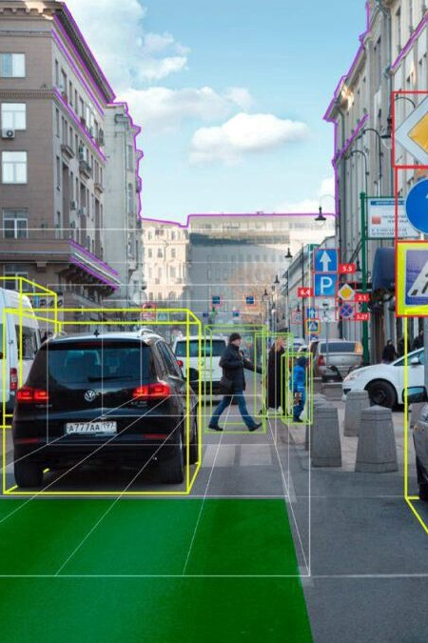
Intro to Computer Vision
Computer vision is an interdisciplinary field that deals with enabling computers to see and interpret information given through images or video.
Computer vision tasks include methods for acquiring, processing, analyzing, and understanding digital images.
Some important domains in computer vision are:
Scene Reconstruction
Visual Servoing
Object Detection
Event Recognition
Tracking
Notes:
- Ultimately, the goal is to develop systems that can gather and interpret data to make automated decisions.
Visual Servoing is especially important in our context since it is the field concerned with using techniques to use feedback information extracted from a vision sensor to control the motion of a robot.
Computer vision is also considered one of the largest fields of application for artificial intelligence as I said before about making decisions.
Artificial intelligence can allow a computer vision system to mimic or even exceed a human’s capability for sight and decision making

Slide 3

Pros of CV for Continuum Robotics
Utilizing CV can yield more information with just the image data
Can help reduce complexity of the robot
Can serve as both an internal and external sensor for robotics
Notes:
Image data can be used for many types of sensing such as sensing light, position of the robot, angle of rotation, and sensing the surrounding environment.
Vision data is much easier to use compared to other sensors to read and understand the orientation and requires much less computation to find the orientation. It is also easier to interpret for people. In human-controlled navigation of continuum robotics, having a camera is very useful.
As we learned in class, internal sensors are used to find position and orientation of the robot and external sensors are used to find information about the environment around the robot. With CV, you can sense both which enables visual servoing.
- For example, CV can be used to locate the target and then use the position and orientation data of robot as a feedback system as it moves closer to the target.

Slide 4
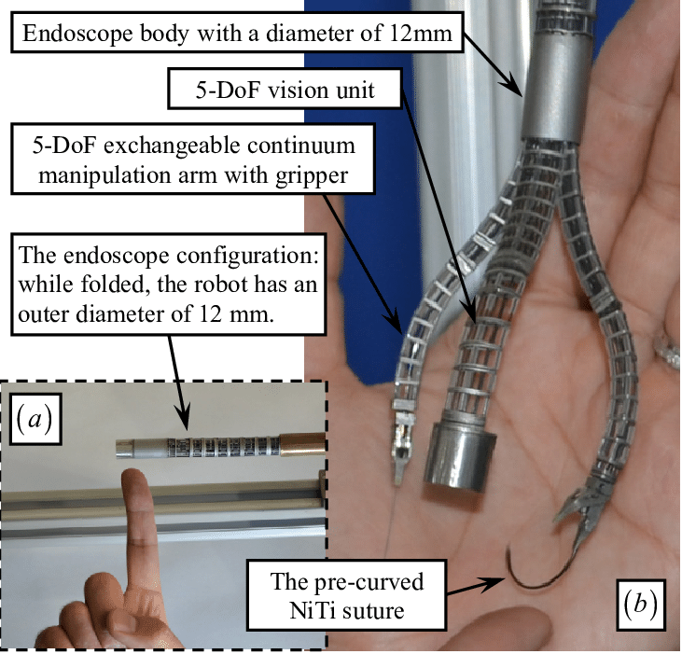
Cons of CV for Continuum Robotics
CV can be limited on what it can sense.
CV can be limited on where it can be used.
CV cannot sense how the robot interacts with the environment.
Notes:
C1:
Visual servoing can be done in two distinct forms, eye-in-hand visual servoing where the camera is attached to the end effector and eye-to-hand visual servoing where the camera is fixed in the workspace.
Eye-in-hand visual servoing can be more adaptable as an external sensor since it can get closer to the desired location and capture data more closely. This is especially useful when sight of the desired location would be blocked by obstacles, but eye-in-hand visual servoing also has the limitation of not being able to perceive the workspace of the entire robot.
Eye-to-hand visual servoing has a visual sensor with a static position which allows for perception of the entire workspace of the robot but cannot change its position to move with the robot.
Also, external factors such as lighting and the background can hinder the effectiveness of CV data.
C2:
If there are limitations on physical space, weight, and sensor input ports on a continuum robot which is typical, Then it will be difficult to use a CV system that must sense in small and cramped environments. RGB-D sensors in particular can be quite large for a continuum robots.
For example, when performing a surgery with continuum robotics, cameras are used but generally lack depth and range data.
C3:
Unlike sensors which use contact and dynamics, CV cannot sense how the robot will interact with the environment. For example, to perform robotic surgery, a lot of specialized training is needed to interpret the image data since there is no depth data (so often you cannot know how far away something is) and no information on what forces are being applied to the environment from the robot.
Dr. Walker actually has a paper written on using tapping to sense the environment which can be used when CV is not an option.

Slide 5
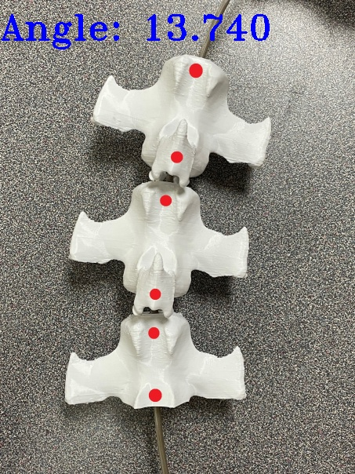
Using CV to Monitor Orientation of a Continuum Robot
The purpose of this project was to create a computer vision system that could monitor the bending angle of a continuum robot.
The continuum robot in this project was based on a pangolin’s tail.
This system could be used to either calibrate movement or measure error of control systems.
This system could also be used as a basis to develop a system for eye-to-hand visual servoing.
Notes:
Often times, continuum robots do not move exactly as we wish, and this can be due to a robot not adhering to constant curvature due to multiple conditions such as gravity or nonlinear deformation due to actuation, or other factors such as material elasticity.
The image to the right is an example of what the system should do as you can see a bend in the bones and an angle that is calculated.

Slide 6
Methodology
Set up the camera to capture video so that the data from the frames can be collected for transformation.
Detect critical parts of the robot using color detection
Contour the images to just the critical parts of the image
Find the centroid of the contours to identify certain points that can be used to create vectors
Compute the angle between the vectors
Output angle data to an Arduino controlling the motors and read feedback
Notes:
All the code was developed in Python using OpenCV. I chose OpenCV over MATLAB due to it being easier to find examples and open-source code to use for the project. OpenCV has more features and has a large community which keeps it updating and growing faster than MATLAB’s computer vision toolbox. It is also faster is very important when using video data instead of just image data.
MATLAB can be better in some contexts due to it being subjectively easier to use as it is very easy to deal with matrix data in MATLAB, has lots of documentation. It also has an easy-to-use IDE and I find its easier to debug with, but the addition of Python to OpenCV makes OpenCV not that much harder if at all compared to MATLAB so I used Python.

Slide 7
Setting Up the Camera for Video Data
The robot is placed onto the table over a white sheet and the camera is placed above it looking down to have a good view of the robot and the workspace.
Video data is then captured using an external camera.
capture = cv.VideoCapture(1)
Camera runs at 30 frames per second, but calculations are only performed every 30 frames.
Notes:
2) This function sets up the video capture. The “1” is used to designate that the video source will be the second camera which is usually the non-webcam camera.
3) This keeps the computer running smoothly without too much lag from running the code 30 times per second.

Slide 8
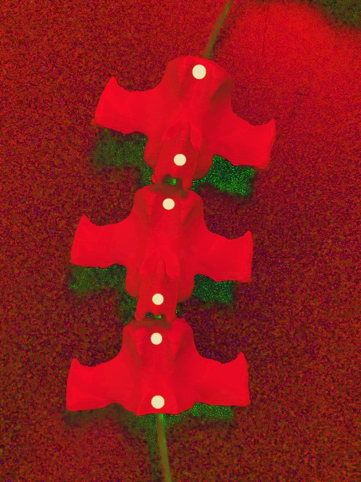
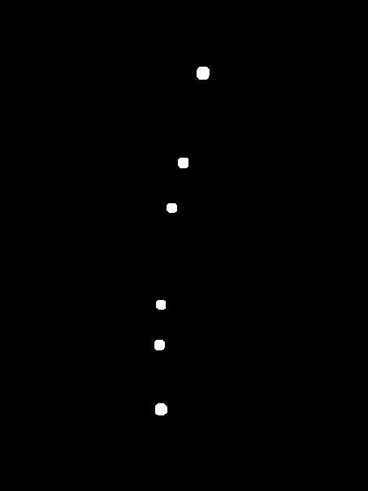
Detecting Critical Parts
For this project, to detect orientation of the robot, colored stickers were used and placed at the bottom and top of the first and last bone segment.
To detect where the stickers were, the captured frame was converted from BGR color space to HSV.
Notes:
The HSV color space is very good at color detection and is generally much better than BGR for many applications.
***Unlike RGB, HSV separates luma, or the image intensity, from chroma or the color information.

Slide 9
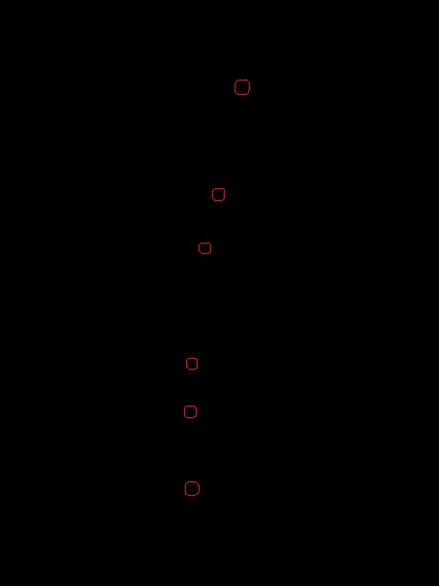
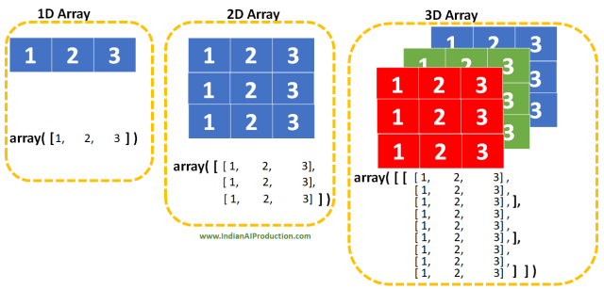
Contour the Images
Contours are an outline representing or bounding the shape or form of something.
In this case, contours were used to find the edges of the masked image.
The findContours function is necessary to set up calculations to find the centroids.
Notes:
The findContours function splits up the mask image which is a 2D array of pixel values, to a 3D array that contains the x,y position of each point in each contour.

Slide 10
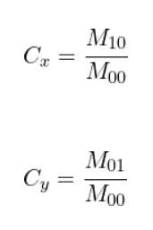
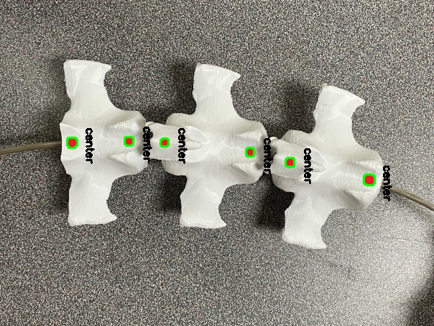
Find the Centroids
The centroids of each contour are calculated to get specific points along the bones.
These points will be used to make an estimate of the orientation of the tail.
For this project, an insertion sort algorithm was used to order the points from left to right.
Notes:
For this image, I found centroids for each bone in the tail, but for the project I only have it for the first and last bone.
The centroid of each contour is calculated with these equations. M10, M01, and M00 can be found using the moments function in OpenCV.
In the workspace, the tail is laid down horizontally, but contours are calculated from top to bottom by default. The sort algorithm makes sure that the points are always in the right order.
One limitation of this is that if the tail completely wraps around, the code will no longer work.

Slide 11

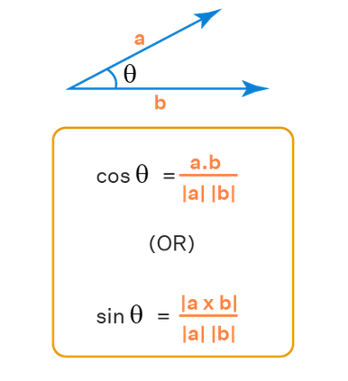
Compute the Angle Between Vectors
Using the points, two vectors are calculated using the centroids of the contours found earlier.
The angle between the vectors is then calculated.
Notes:
The angle between the vectors was found by calculating the dot product and dividing by the product of the magnitude of the vectors. Then arccos was applied to that and the angle is given.

Slide 12
Output Data to an Arduino
The program could easily communicate with an Arduino thanks to the PySerial library.
To send serial data to the Arduino, the angle was first formatted into a string before being sent over.
Notes:
The process of creating the vectors, calculating the angle, and communicating with the Arduino is only done once every 30 frames.
Also, this process is only done when 4 centroids are calculated to make sure no bad data is sent to the Arduino.

Slide 13
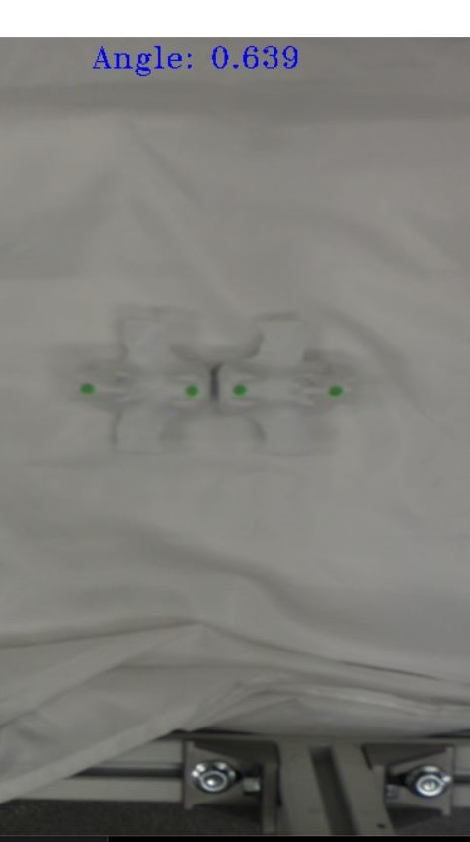
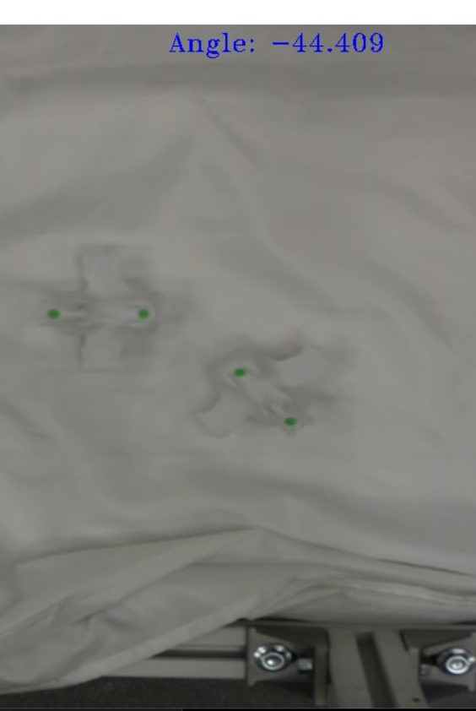
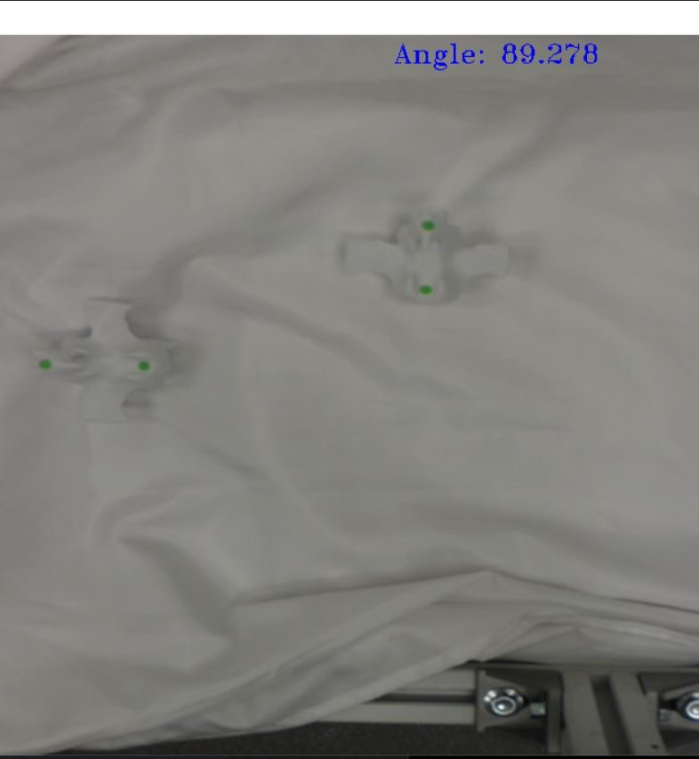
Results

Slide 14
Next Steps
Use the system to aid in visual servoing by integrating the CV code with the actuation of the tail controlled by the Arduino.
Include a way to allow user input for the target.
Design a control system that uses the current angle as feedback while it moves towards the target angle.
Calculate angles between each bone segment of the tail
Add sensing capabilities for 3D space
Notes:
Currently there is communication between the Arduino and the Python code, but we have not yet begun actuating the tail yet.
In the future, a user should be able input an angle at which they want the tail to move towards.
This is outside of the scope of the Python system but adjustments may be needed.
Knowing the angle of each bone segment can be used to know the complete shape of the robot at each point in time and can be used in the far future for things such as simulating grasping objects or multiple bends in the tail.
Right now, the tail can only curl about the Z-axis, so a project could be done to extend this by using cameras to sense rotation about the X and Y axis.

Slide 15
References
M. Hannan and I. Walker, "Vision based shape estimation for continuum robots," 2003 IEEE International Conference on Robotics and Automation (Cat. No.03CH37422), 2003, pp. 3449-3454 vol.3, doi: 10.1109/ROBOT.2003.1242123.J. Clerk Maxwell, A Treatise on Electricity and Magnetism, 3rd ed., vol. 2. Oxford: Clarendon, 1892, pp.68–73.
A. AlBeladi, E. Ripperger, S. Hutchinson and G. Krishnan, "Hybrid Eye-in-Hand/Eye-to-Hand Image Based Visual Servoing for Soft Continuum Arms," in IEEE Robotics and Automation Letters, vol. 7, no. 4, pp. 11298-11305, Oct. 2022, doi: 10.1109/LRA.2022.3194690.K. Elissa, “Title of paper if known,” unpublished.
Feng, F., Hong, W. & Xie, L. A learning-based tip contact force estimation method for tendon-driven continuum manipulator. Sci Rep 11, 17482 (2021). https://doi.org/10.1038/s41598-021-97003-1Y. Yorozu, M. Hirano, K. Oka, and Y. Tagawa, “Electron spectroscopy studies on magneto-optical media and plastic substrate interface,” IEEE Transl. J. Magn. Japan, vol. 2, pp. 740–741, August 1987 [Digests 9th Annual Conf. Magnetics Japan, p. 301, 1982].
Wang X, Li Y, Kwok KW. A Survey for Machine Learning-Based Control of Continuum Robots. Front Robot AI. 2021 Sep 24;8:730330. doi: 10.3389/frobt.2021.730330. PMID: 34692777; PMCID: PMC8527450.
“Visual servoing,” Wikipedia, 21-Nov-2022. [Online]. Available: https://en.wikipedia.org/wiki/Visual_servoing. [Accessed: 08-Dec-2022].
M. B. Wooten and I. D. Walker, "Environmental Interaction With Continuum Robots Exploiting Impact," in IEEE Robotics and Automation Letters, vol. 7, no. 4, pp. 10136-10143, Oct. 2022, doi: 10.1109/LRA.2022.3192771.

